Slide 1
Data Science Project

Slide 2
Ecommerce Product Categorization
1. DATA IMPORT AND PREPROCESSING
2. EXPLORATORY DATA ANALYSIS
3. FEATURE ENGINERRING / Word Embedding
4. MACHINE LEARNING MODEL BUILDING, EVALUATION
5. PREDICTIONS ON TEST DATA

Slide 3
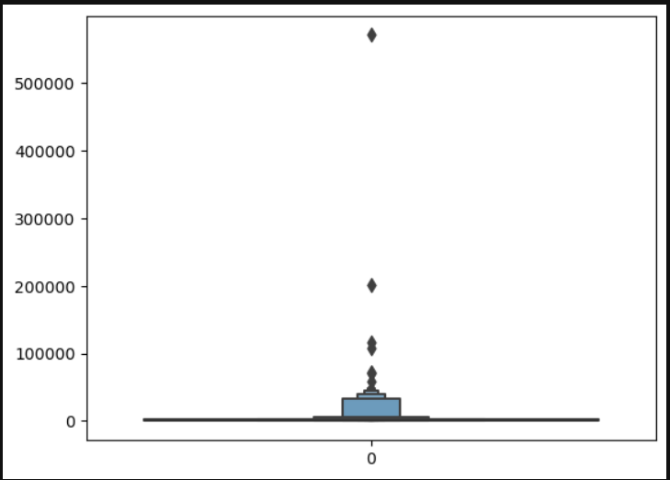
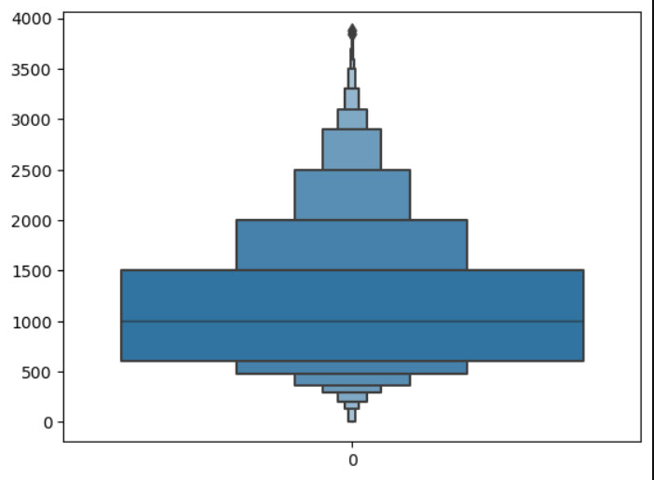
DATA IMPORT AND PREPROCESSING
Necessary Libraries were Imported to carry out preprocessing
Data imported and various parameters were used to understand the data like info, shape, null values, outliers
Dealing with null values ‘fillna’ function was used to deal with null values
Treating the Outliers is a very important part of preprocessing as it can create an huge impact on our model.
IQR – Interquartile Range method was used to treat the outliers & Box plot was used to show the outliers
Data With Outliers
Data Without Outliers

Slide 4
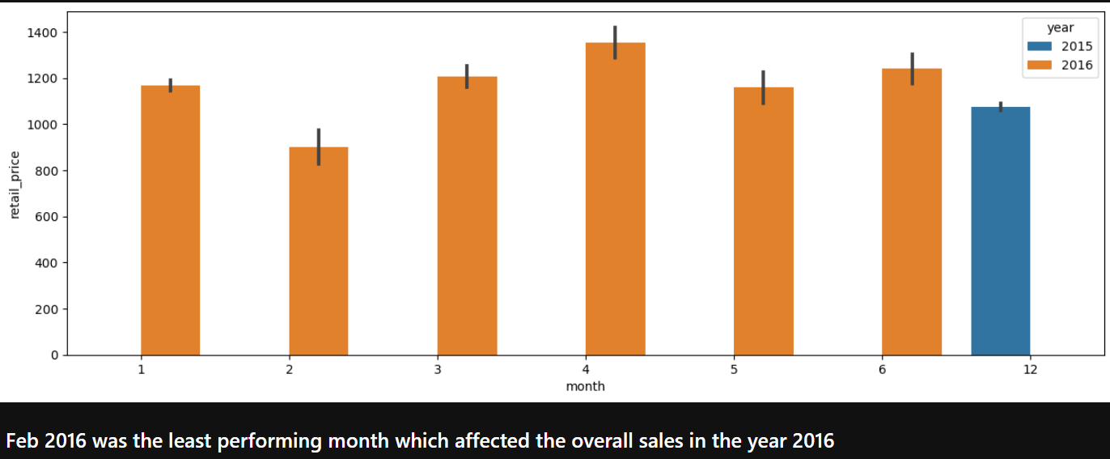
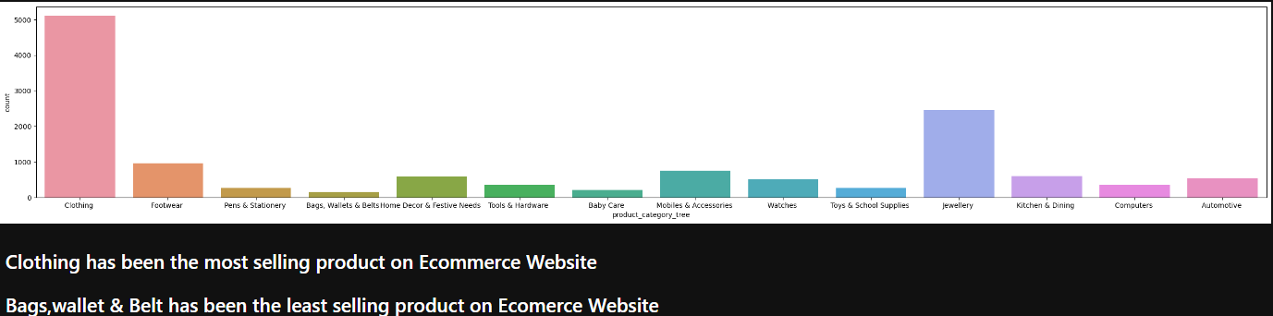
EXPLORATORY Data ANALYSIS (EDA)
Feature extraction technique used to derive ‘month and year’ from a timestamp. Result was I was easy to find out ‘Best performing month for 2015’
Count plot was used to find out best & Least selling product

Slide 5
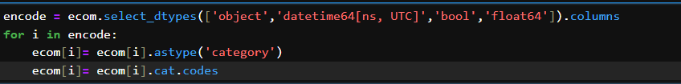
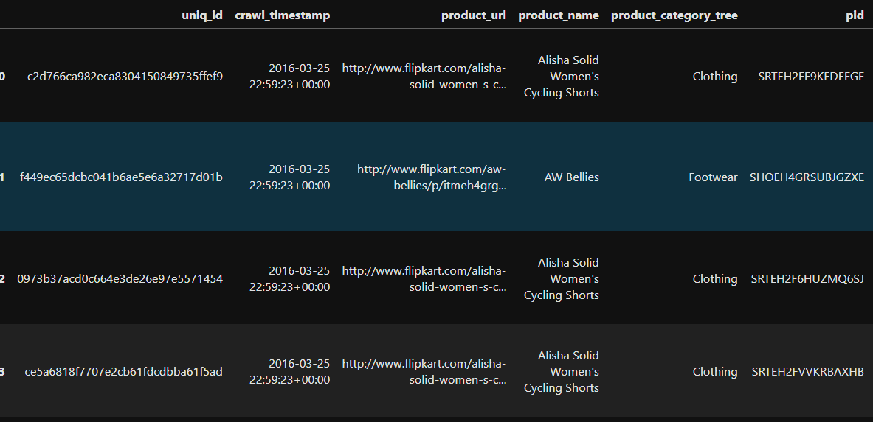
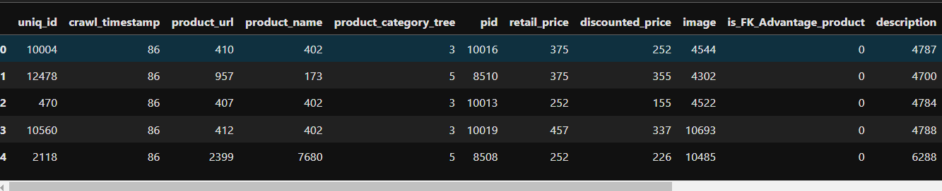
Word Embedding (Encoding)
‘Cat Codes’ Technique was used to convert a categorical data into Numeric Data.
Data with Categorical Values
Data converted to numeric Values

Slide 6
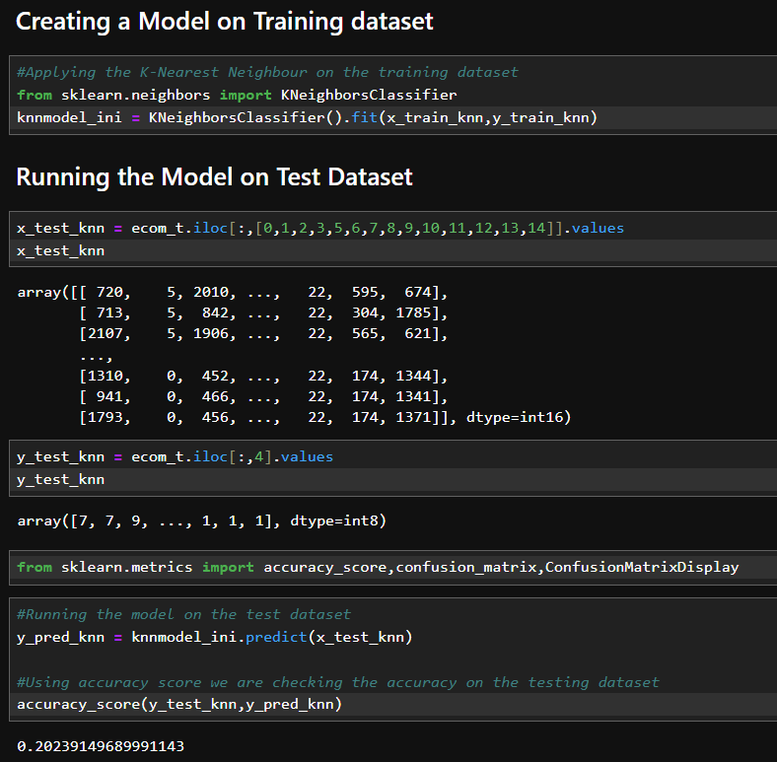
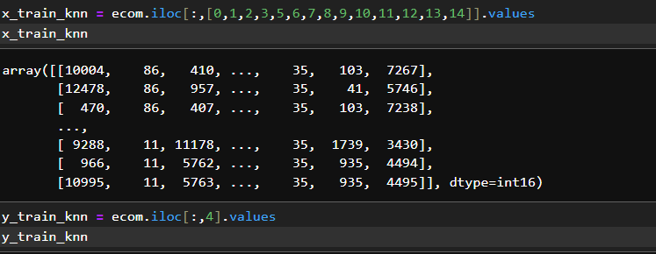
MACHINE LEARNING KNN MODEL
X and Y Features and Labels for training data
Fitting the train data to KNN Model and then Running the model on the test data

